Slide 1

ARK Fund Applet
Brandon (ShyuShiro) Jan2021

Slide 2
Disclaimer
I am not a financial adviser
This applet project is purely for my own education in both programming & finance
If you wish to use this project for your own purposes, please use responsibly
I am not a lawyer
I assume that because the information is publicly available to download, it is therefore reasonable to play with the data
However most of the time … assuming is never right! Therefore, I am not a lawyer

Slide 3
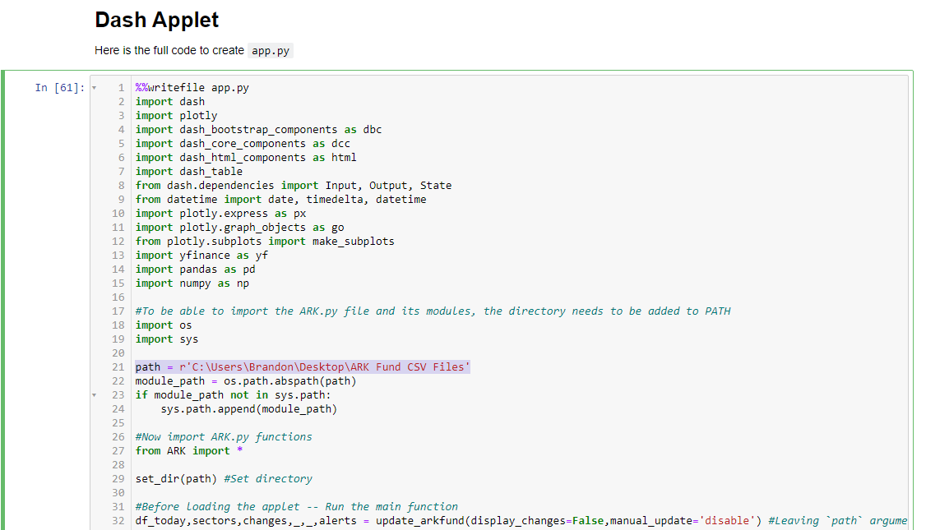
How to run the app
1) Download the github repo
2) Have python (im using Python 3.9)
You can download standalone python or go the typical route of downloading `anaconda suite` which will come with anaconda
3) Edit the directory location in `app.py` to path containing “ARK.py”
4) Execute the “app.py” applet via cmd
Ex: “py app.py” or “python app.py”
Be sure to `cd` into the appropriate directory
5) Open browser to “http://localhost:8050/”
Enjoy~

Slide 4
How to automate downloading ARK files
Link the `ARKFund_DownloadScheduler.bat` to your python.exe
{path to python.exe} “{path to ARKFund_DownloadScheduler.py}”
Ex: C:\Python39\python.exe "C:\Users\Brandon\Desktop\ARK Fund CSV Files\ARKFundDownload.py“
Google “Windows Task Scheduler”
Schedule a daily task for executing the `.bat` file
Be sure to put “execute in path: {directory of repo folder}”

Slide 5
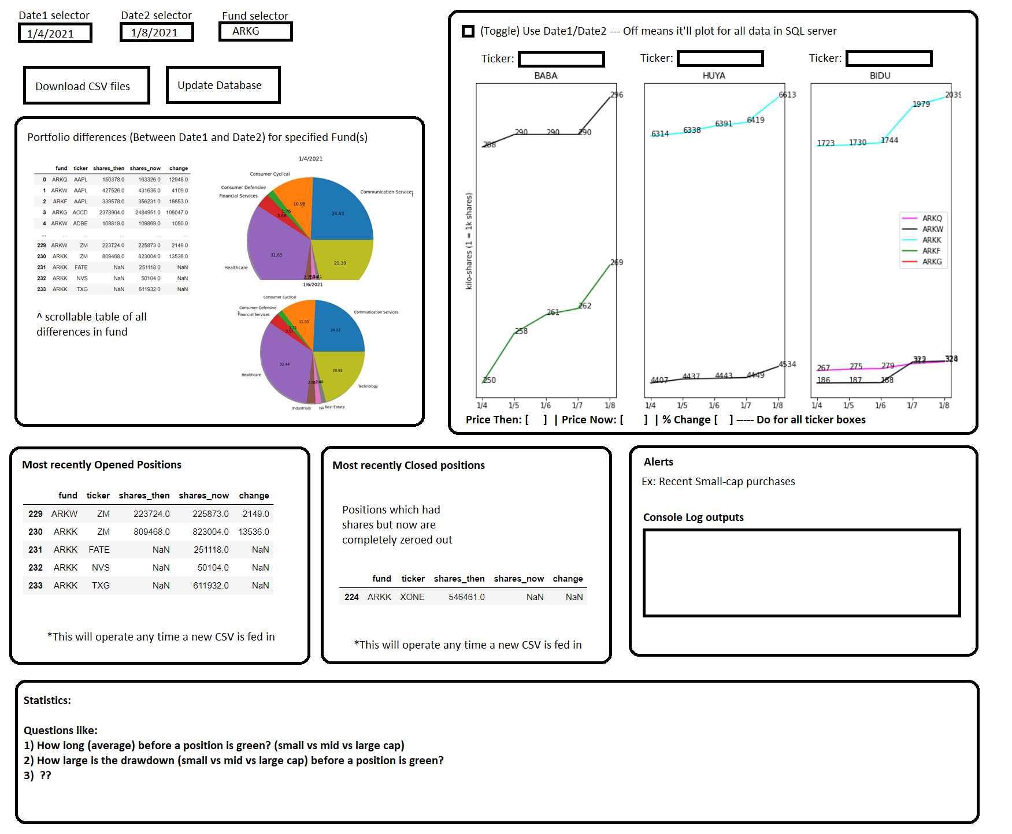
Applet Design (Brainstorm)

Slide 6
Project Statement
Cathie Wood (ARK Investments) has gained a lot of attention in 2020
Her transactions are very transparent (daily alerts) and have impact on the state of the market
Wouldn’t it be great to know what she is investing in at any point in time?!
Wouldn’t it be great to know if she has been accumulating shares in a falling stock? (Ex: BLI during January she has been buying as the share price continues to drop!)

Slide 7
Goal
Applet that runs locally
Not shooting for website hosting (not even sure how legal it is to utilize this data publically --- but it seems pretty safe considering there exist website to do this very thing)
Ex: https://cathiesark.com/
“If an app already exists, why make your own?”
Mine is different in some aspects
Mine shows individual fund allocation into a stock but cathiesark shows a total summed position in the ticker in their ticker_chart
Mainly doing this for learning & education

Slide 8
The following slides are information on my progress
I started this project back on 4Jan2021 to download the data
Building the functions to actually host a sqlite3 database and all that didn’t begin until probably that weekend (8Jan2021)
Eventually I realized this project could be pretty big & thought why not document my work.

Slide 9
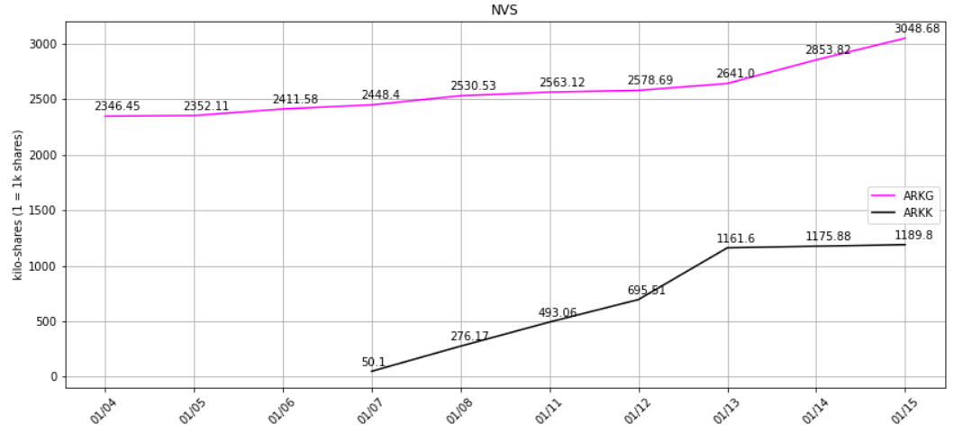
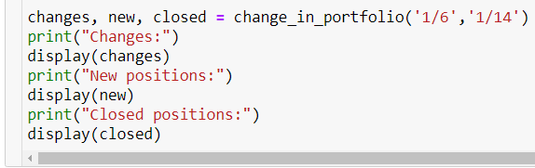
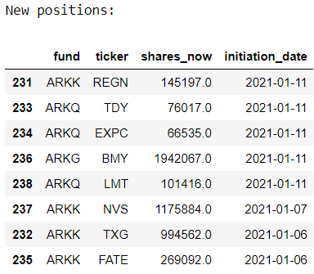
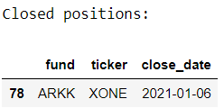
Change Logs – 1/17
Change_in_portfolio() issues:
1) date1/date2 required
2) new df wouldn’t properly populate unless the new position occurred on the exact transition from X to Y date
3) same issue as #2 with `closed` df
Solution:
1) Now defaults to previous day + current session if not provided
2) Created `unique_dates` & `loc_initial_date` variables so that “1/11” would expand the search to “1/10”… because you can’t know a position is new unless you know it wasn’t there yesterday.
3) Along with #2’s soln, changed `a` and `b` to generate from `unique_dates[loc_initial_date]` instead of `date1` to capture that initial date
4) Did some small house cleaning by dropping unnecessary columns (like cap,market_cap) in preprocessing
ticker_lookup() Issues:
1) “FATE” (ARKK had started purchasing it on 1/7) would screw up the x-axis
2) Legend was incorrectly stating which fund was which line (Ex: ARKG doesn’t buy Paypal)
Solution:
1) Created `date_val` and `date_label` variables to appropriately handle a changing x-axis
2) Created `fund_labels` to appropriately point the data to the fund
This command now correctly notes any new/closed positions between the dates provided

Slide 10
Change Logs – 1/17
change_in_portfolio update
Functionality for an “alert” system prompted the computation of “Percent Change” column
Alert system update
Need to find a way to trigger an alert message whenever X occurs
Currently taking X as a 10% increase or decrease in position sizing

Slide 11
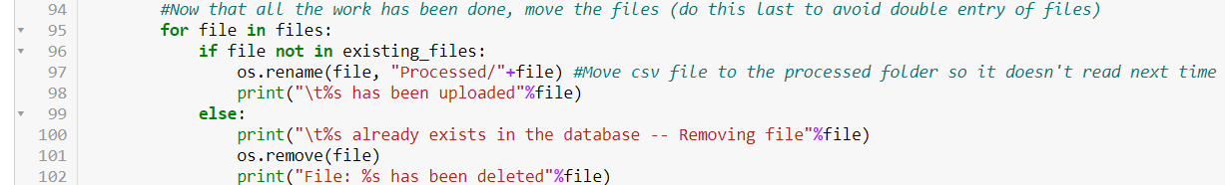
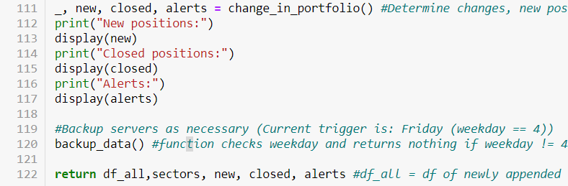
Change Logs – 1/18
update_arkfund()
Issue:
Holidays such as MLK weekend will still trigger the download script, but the data already exists from a previous date.
Soln:
Remove file if it exists (previously only mentioned the file was duplicate but took no action)
update_arkfund()
Alerts:
Best time to run alerts is when the main script is ran
Moved “change_in_portfolio” earlier in the jypnb and called the function at end of update_arkfund()

Slide 12
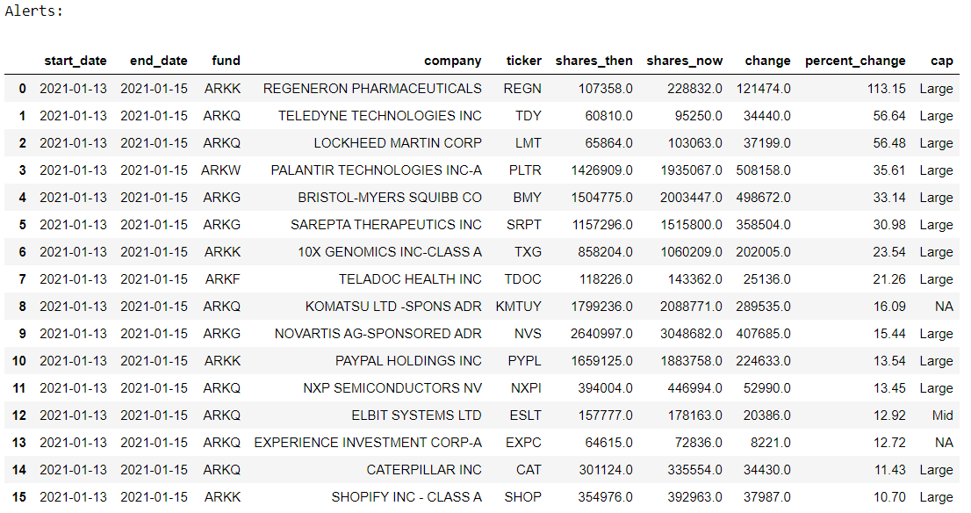
Change Logs – 1/18
change_in_portfolio()
Alert functionality
Added new output “alerts”
Copied “changes” and searched for >abs(10%) change in position sizing

Slide 13
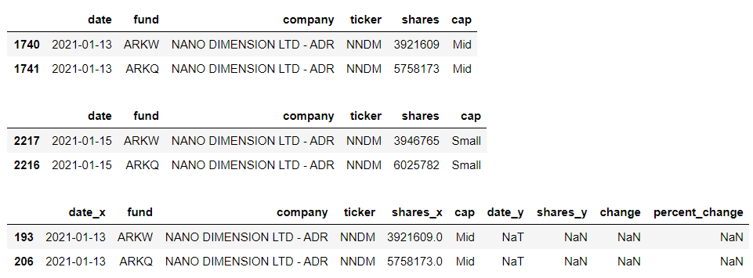
Change Logs – 1/18
change_in_portfolio()
Issue:
Cap size changing
Already knew this would become an issue eventually
Merged DF errors because “cap” changes between these dates and resulted in “shares_y” = NaN
Solutions:
a) Could update cap size for all entries daily
b) Modify `sectors.db` to include [‘cap’,’market_cap’] and update that every so often (avoids the updating of cap/market_cap within the arkfund.db --- however requires calls to `sectors.db` separately to append data together in functions that require that info.
Leaning toward solution (b)
1/13 “Mid”
1/15 “Small”
a.merge(b) --

Slide 14
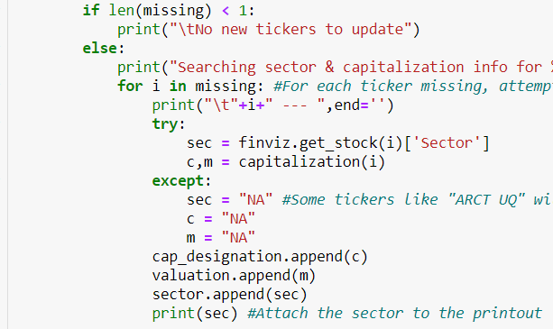
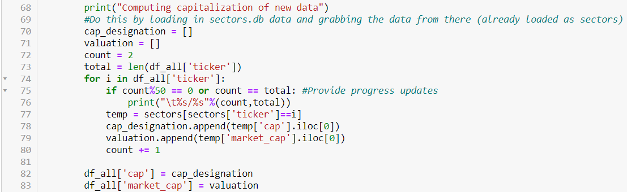
Change Logs – 1/18
update_sectors() / update_arkfund()
Per previous slide … moved capitalization() function that was sitting inside update_arkfund() into update_sectors()
Per that action
1) sectors.db now contains [‘cap’,’market_cap’]
2) ARKFunds.db still contains [‘cap’,’market_cap’] --- however no does not compute updated capitalization values … it merely references (1) and steals it from sectors.db upon loading new data
Could alternatively remove this info from the table, but when the database grows I worry making calls to 1 year of data may slow the processing if it has to load ARKFund.db AND sectors.db THEN merge to create ‘cap’,’market_cap’ for ARKFund.db’s dataframe in memory for EACH function that makes this call
3) update_capitalization() function’s purpose was to update cap & market_cap data for `ARKFund.db` but now needs to be repurposed for to update BOTH `ARKFund.db` and `sectors.db` appropriately
update_sectors() changes: Added c,m & subsequent vars
update_arkfund() changes: Modified capitalization code to grab from sectors (already loaded var)

Slide 15
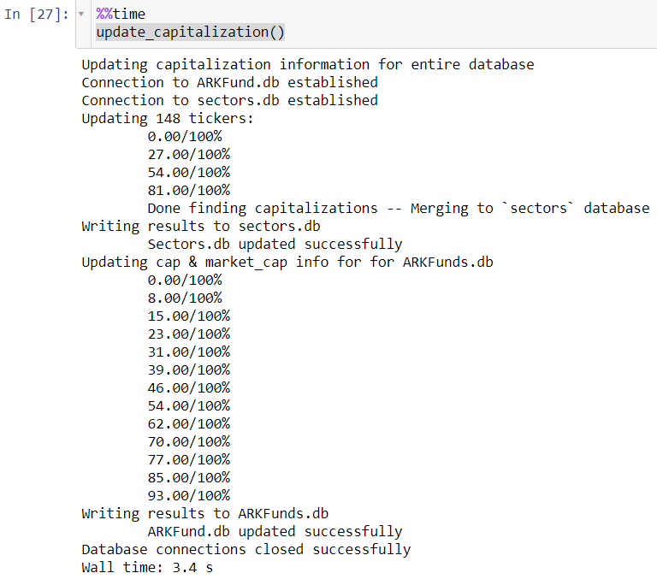
Change Logs – 1/18
update_sectors() / update_arkfund()
Per previous slide … moved capitalization() function that was sitting inside update_arkfund() into update_sectors()
Per that action
1) sectors.db now contains [‘cap’,’market_cap’]
2) ARKFunds.db still contains [‘cap’,’market_cap’] --- however no does not compute updated capitalization values … it merely references (1) and steals it from sectors.db upon loading new data
Could alternatively remove this info from the table, but when the database grows I worry making calls to 1 year of data may slow the processing if it has to load ARKFund.db AND sectors.db THEN merge to create ‘cap’,’market_cap’ for ARKFund.db’s dataframe in memory for EACH function that makes this call
3) update_capitalization() function’s purpose was to update cap & market_cap data for `ARKFund.db` but now needs to be repurposed for to update BOTH `ARKFund.db` and `sectors.db` appropriately
4) Also updated capitalization() to say “Nano” instead of “NA” for companies that don’t fit Micro,Small,Mid,Large
update_capitalization() changes:
Added functionality to update sectors.db
THEN use that info to update ARKFund.db
… it runs so fast! (only ~4s for 1/4 - 1/15 data)

Slide 16
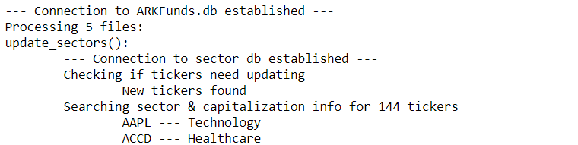
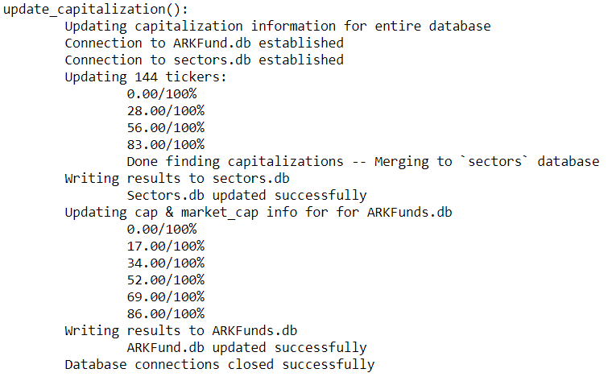
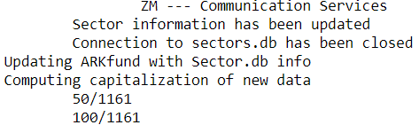
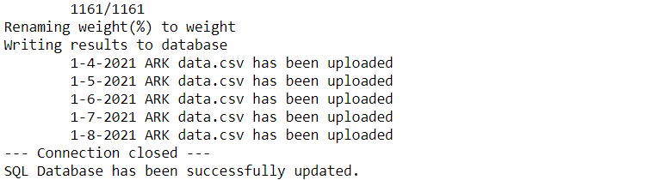
Change Logs – 1/18
Changed printout
Update_arkfund() is the main function and it has a lot of printouts … it’d be great to know which subroutine is currently running → Change prinouts of various things to make it clearer
In general … just adding print({name_of_function():}) and tabbing everything an additional tab over
Update_sectors()
Backup_data()
Update_capitalizations()
Here is the printout of 1/4 to 1/8 data loading:
Running all (except backup_data) and
processing 1/4 – 1/8 data only took 6s! (33s if sectors.db actually has to be updated)

Slide 17
Change Logs – 1/18
Recap
Update_arkfund() was always the main function … but didn’t fully fulfill that purpose
Update_capitalization() has been pushed into update_arkfund()
Change_in_portfolio() has been pushed into update_arkfund()
Change_in_portfolio() also now reports an “alerts” df of significant change in share size
Sectors.db has been updated to contain [‘cap’,’market_cap’] information
Subsequently ARKFund.db still contains that info, but now obtains its capitalization information from sectors.db instead (resulting in faster processing & less calls to the finviz API)
This change resolves issues that I foresaw could arise in computation (where cap size differs from 1 trading session to the next). With the data coming from sectors.db the information will be unified across trading sessions --- and update_capitalizations() will run on a weekly Friday basis to keep it up-to-date
Update_arkfund()
Now takes action to delete duplicate files --- this handles situations like MLK holiday where the script will download even though no new data would have been generated by ARK investments

Slide 18
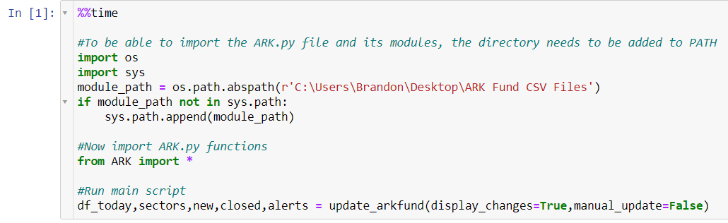
Change Logs – 1/19
Biggest Change:
Created “ARK.py”
A Python script that contains all the functions created in the jupyter notebook
This allows ease of access and will compact the coding when writing the Applet in Dash/plotly
In my previous projects, I would copy/paste all the necessary functions to the top of the applet
Resulting in a cluttered mess of +500 lines of code before the App.py file would be writing the applet itself (just ugly to read)
Segmentation of the code from functions and the Dash/plotly app will make it clearer for pushing changes
To do this
Simply add the ‘ARK.py’ file to PATH via os and sys …
Then import *

Slide 19
Change Logs – 1/19
change_in_portfolio()
debug = False argument
Added additional debug printout for date1 and date2 to be printed
update_capitalization()
Added new argument:
manual_update = False
Argument will allow manual triggering of the subroutine on any day (because current execution requires day to be Friday)
Update_arkfund()
Added new argument:
manual_update = False
Per change to update_capitalization, giving the main function the ability to pass the argument further down

Slide 20
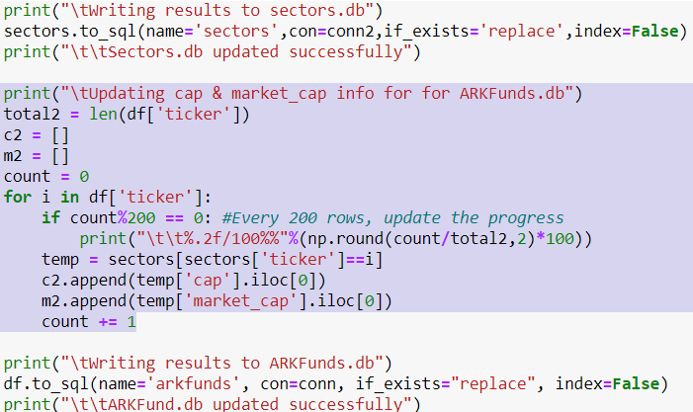
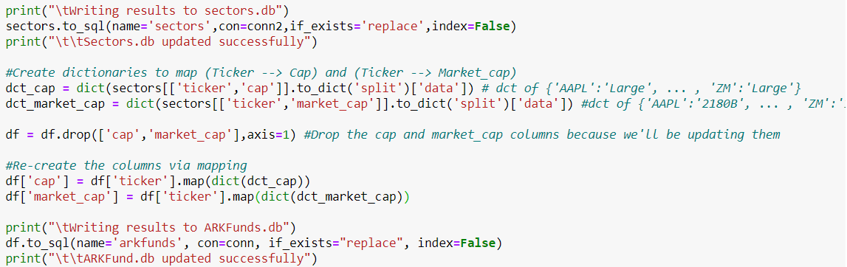
Change Logs – 1/19
update_capitalization()
Method of computing [‘cap’,’market_cap’] for `ARKFund.db` after computing `sectors.db` via Finviz
Previously it would iterate through all n-rows of ARKFund.db
Now it converts `sectors.db` into a dictionary and utilizes a dictionary map (much much faster!)

Slide 21
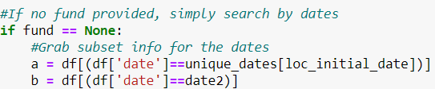
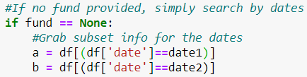
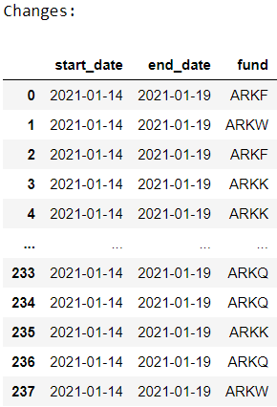
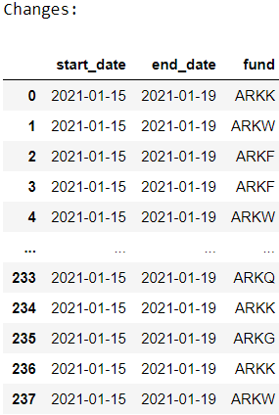
Change Logs – 1/19
Change_in_portfolio()
To account for new & closed positions I created unique_dates[loc_initial_date] variables to grab “1/14” if “1/15” was input
Issue: `Changes` df was referencing the changes from “1/14” to “1/19” (2 sessions) instead of “1/15” to “1/19) (1 session) which further impacted the `Alerts` df to account share differences from “1/14” to “1/19” … pushing too many alerts.
Previously
Now
Result:
Not good!
Result:
Good!

Slide 22
1/20 Notes:
Tried looking for “ark fund data csv archive” to try and download more data from previous dates …
Could not find any archive to download from
Instead, found there exists a website doing EXACTLY what I’m doing!
https://cathiesark.com/ark-funds-combined/complete-holdings
Similarities
1) Shows daily trades
2) Shows Newly opened positions + Date of initiation
3) Shows Closed positions + Date of closure
4) Charts to show the fund’s holding of a ticker
Differences
1) Charts showing fund’s holding of a ticker
They also display the price of the stock along side the share count in a xyy plot
2) I plan to add functionality to visualize sector differences between 2 specified dates
3) When diving down into 1 ticker, they display all transactions in the history of the ticker (Very easy to include this … since that info is required to initially plot the chart)
4) In general the website has functionality to link you to more sources of information (Ex: The ticker icon + Company information)
5) I plan to add “Alerts” to notify any significant changes to fund positions
6) I plan to build in statistics about the fund
How long before a position becomes green (differing by cap size)
How much of a downdraw before a stock becomes green (differing by cap size)
These would require pulling in stock pricing information! Need to figure how to work that into the database (Unless it can be easily queried)

Slide 23
1/20 Notes:
Pushing to App!
Concerns:
1) matplotlib plots are different than Dash/plotly plots
Hope I can use matplotlib
Otherwise, plotly will require modification of the plots
2) “name 'display' is not defined” when running “app.py”
Display is a jupyter notebook function that displays a dataframe … Probably need to change all of those to “print”

Slide 24
Change Logs – 1/22
Pushed to applet yesterday (1/21) but mostly just ran into issues of converting from matplotlib to dash/plotly.
Ticker_lookup() vs ticker_lookup_dash()
Lookup() was generating a matplotlib figure which does not work for dash/plotly
Lookup_dash() only generates a pd dataframe with the necessary information for dash to generate a plot
Update_capitalization()
Previously:
Updates every Friday
Now:
Manual_update==[True,False,’disable’]
Now when manual_update=“disable” it will ignore the updating
Need to design a way for this to only run once after market hours & never trigger again for Friday.

Slide 25
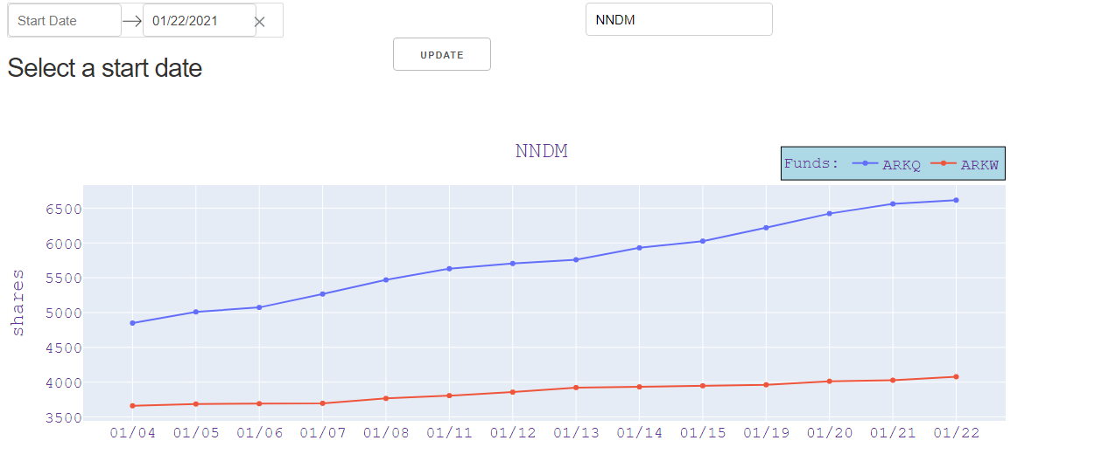
Change Logs – 1/22
Dash applet
Chart functions! (however the date selector is still not tied to it)
To do list:
1) Tie date selector to this (maybe?)
2) Place the “update” button better
3) Add tables for displaying new/closed/changes/alert df

Slide 26
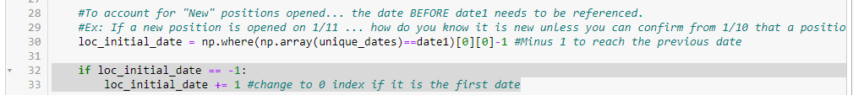
Change Logs – 1/23
Error in `changes_in_portfolio` found … if `date1` was set to the 1st value (‘1/4/2021’) it would error
Solution:
Update_arkfund(‘display_changes=False’)
Issue: print() is an ugly command in jpynb … I prefer “display()” and since the command controls whether or not something is displayed (and its default turned off) I opted to revert a previous change.
Now:
Utilizes display() --- which will cause errors outside of jpynb

Slide 27
Change Logs – 1/23
New function: store_logs(changes,new,closed,alerts)
Purpose:
Combat the issue of “What if cathie closes a position, but re-opens it in the future?” --- Because I believe my code would not properly handle it as a “new” position
Function:
Take input from `changes_in_portfolio()` to update log files
{date} changes.csv
{date} alerts.csv
New_positions.csv
Closed_positions.csv
The changes/alerts have dates attached as I may want to display or reference previous data for statistics
new/closed do not have dates … instead they are perpetually additive csv files which will update with each new new/closed position that is created (checked on a previous vs current trading session rate --- and pushed into the log file)

Slide 28
Change Logs – 1/23
Update_arkfund()
Added subroutine to execute “store_logs(changes,new,closed,alerts)”
Added output for “changes” df which was previously not saved in the generation process
Got rid of a print() that was occurring in the `change_in_portfolio()` function

Slide 29
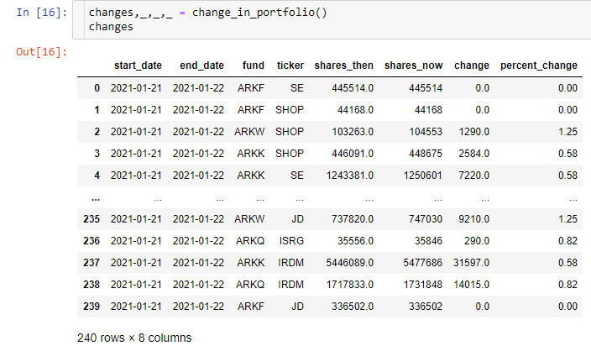
Change Logs – 1/23
`Change_in_portfolio()`
Issue
There are entries which have no reported change (and thus should not be here)
Solution:
Drop columns if “Change” is 0

Slide 30
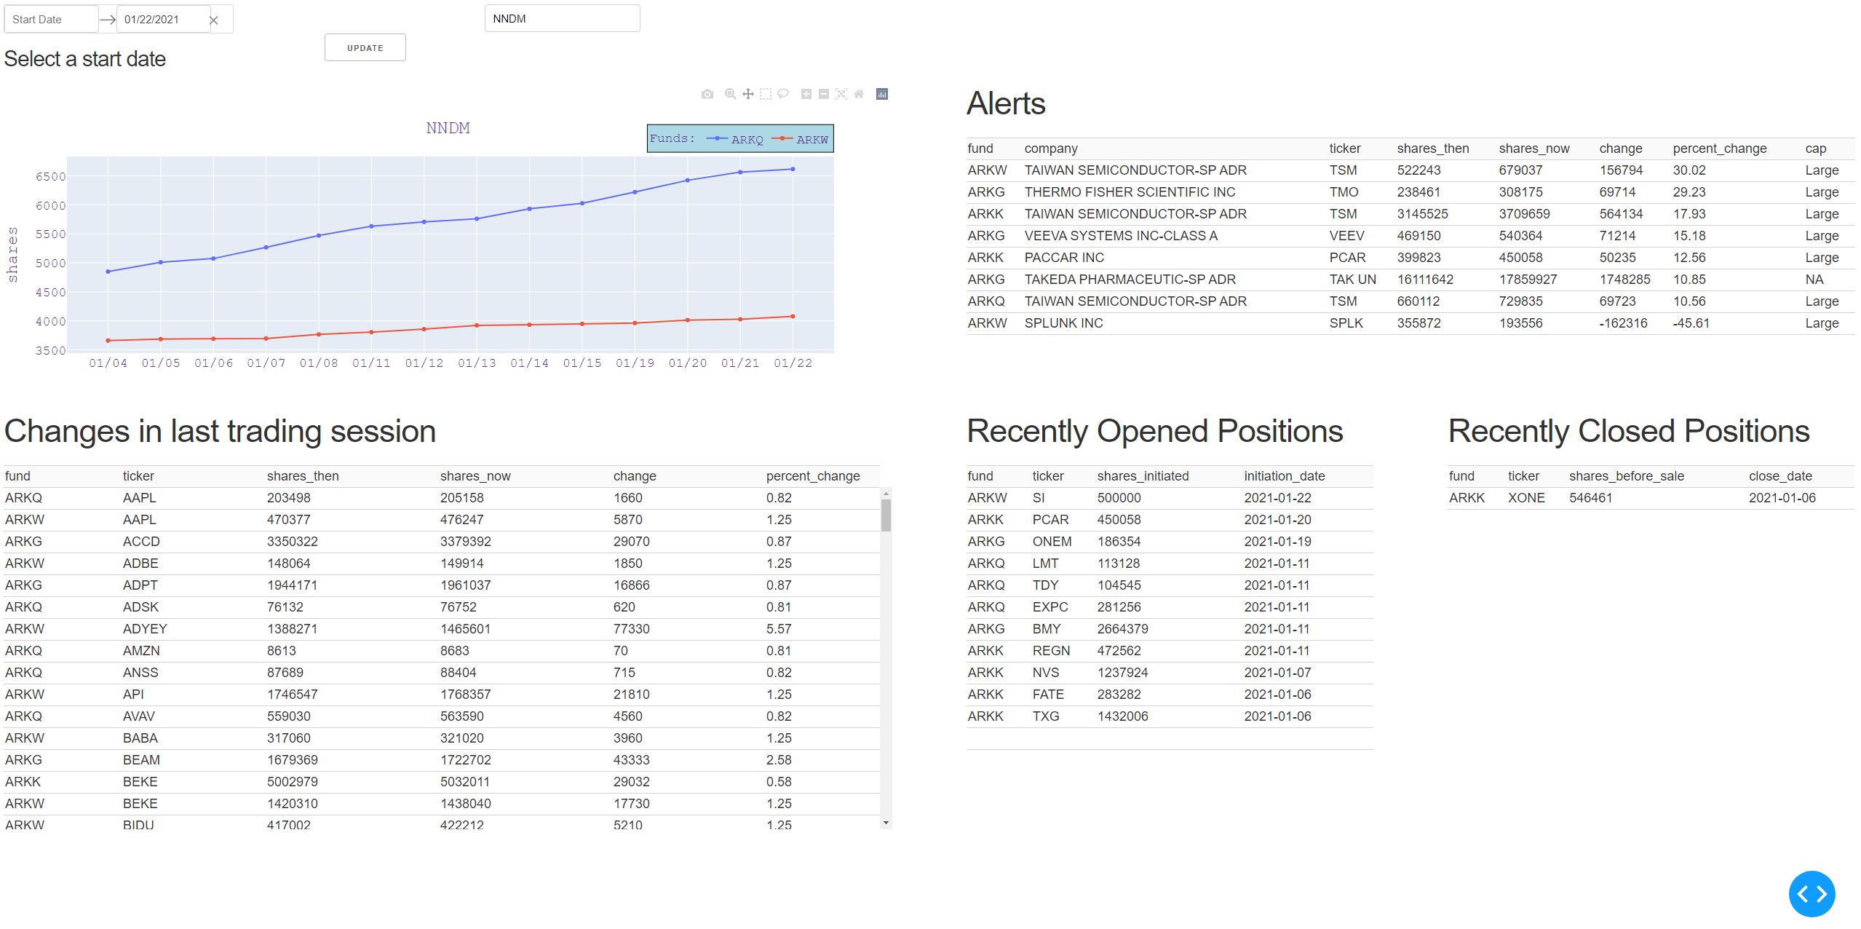
Change Logs – 1/23
Dash applet – Added tables by referencing the `store_logs()` generated files

Slide 31
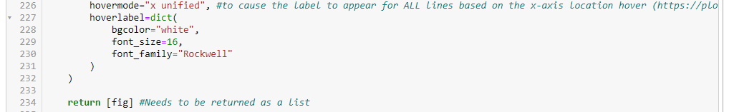
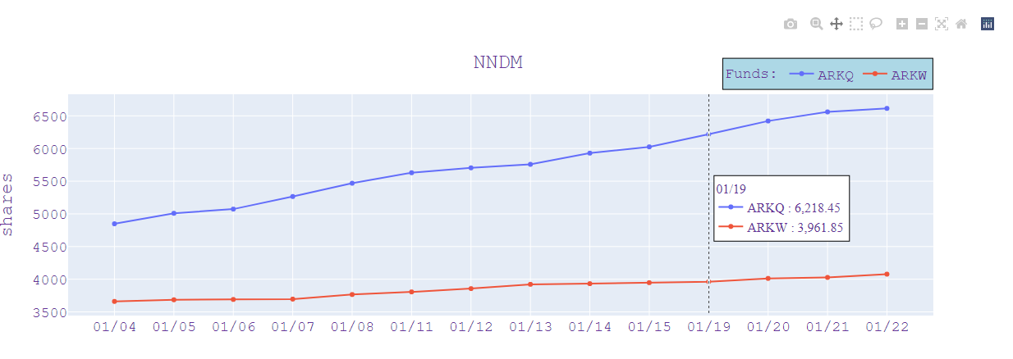
Change Logs – 1/23
Dash applet – Found a way to display the graph data better on hover-over
Fig.update_layout() function called “hovermode” and “hoverlabel”
https://plotly.com/python/hover-text-and-formatting/

Slide 32
Change Logs – 1/23
To do list:
1) Date selector … Original intent was to allow date filtering … but its not too useful yet (either hold off or delete)
2) Conditional format BUY and SELL in `changes` to be GREEN and RED respectively (https://dash.plotly.com/datatable/conditional-formatting)
3) Add a header somewhere to note “Data last updated: { }” where {} is filled by the `current_trading_session` variable
current_trading_session is obtained from the `changes` df in which it grabs the [‘end_date’] column’s value … so it’ll be updated when the new data gets fed in
4) The `textbox` might be better off as a selector box much like my Yelp project … feed in a list of unique tickers that are available to be searched (if a search for “GME” is done it’ll just return that no such ticker exists)
5) Read in & display the most up-to-date information on ARK fund portfolio holdings maybe?
Also should create a selector option to filter between [ARKK,ARKQ,ARKF,ARKG,ARKW,Combined]
6) Pretty the app up
7) Figure out how I’m going to program the statistics stuff of things
How much profit
How much drawdown
… That stuff

Slide 33
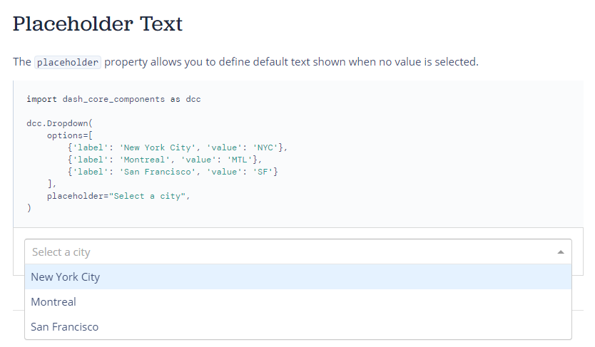
Continued 1/23 to-do list
For 5 – the selector box
See documentation on right (https://dash.plotly.com/dash-core-components/dropdown)

Slide 34
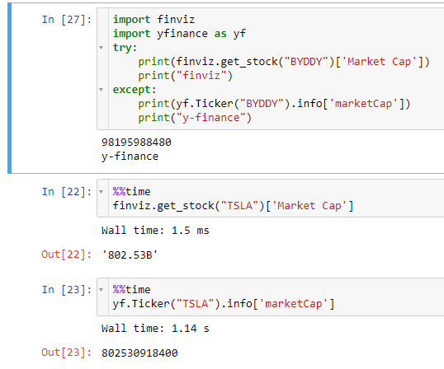
Change Logs – 1/24
Finviz vs yfinance
Originally the project was done in yfinance, but moved to finviz because the compute time is significantly faster (10x faster as shown on the right)
However I have come to realize some tickers, especially those on OTC or international markets, are not recognized by the finviz unofficial API (Examples below)
BYDDY (China market)
TAK UK (Actual ticker is TAK)
Will need to update the following functions to resort to yfinance if finviz does not work … but use a try/except/else statement to catch the cases where neither are successful
update_sectors()
capitalization()
update_capitalization()

Slide 35
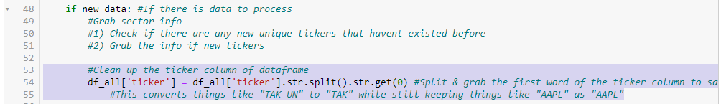
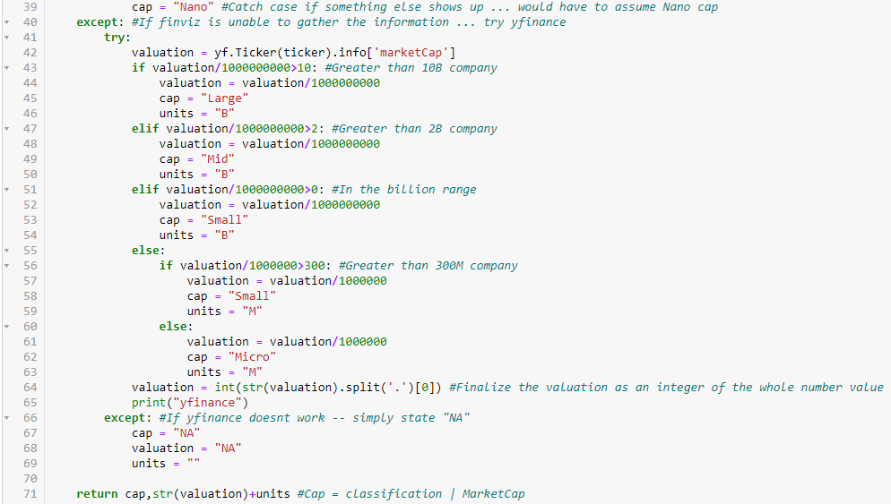
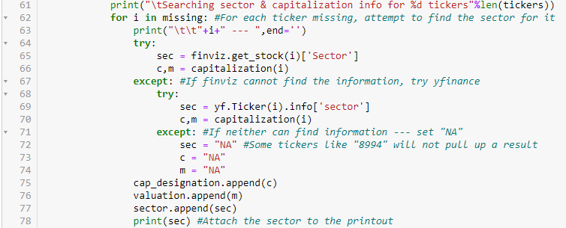
Change Logs – 1/24
Change to update_arkfund()
split ticker like “TAK UN” to “TAK”
Change to update_sector()
Utilize yf as a backup if finviz cant find a result
Changes to capitalization()
passes to yfinance if finviz failes before giving up

Slide 36
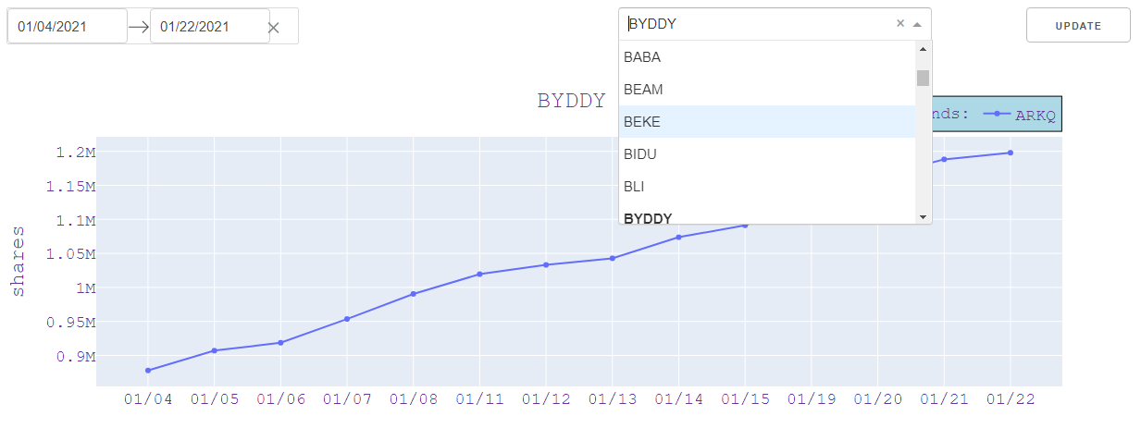
Change Logs – 1/24
Textbox is now a Dropdown object populated with the unique tickers available
The previous slide’s changes are reflected in that tickers such as “BYDDY” are now available for search (and thus are now in the database)

Slide 37
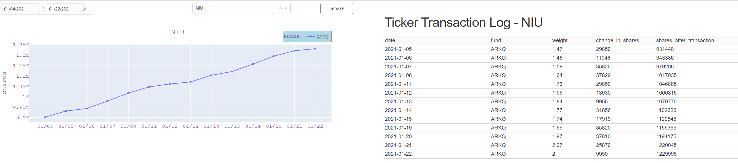
Change Logs – 1/24
New function “compute_transactions(ticker,start_date,end_date)
Computes the transaction log for a ticker
Linked it up with the date selector & ticker search

Slide 38
To do list update – 1/24
To do list:
1) Date selector … Original intent was to allow date filtering … but its not too useful yet (either hold off or delete)
Decided to link to both ticker chart & transaction log table
2) Conditional format BUY and SELL in `changes` to be GREEN and RED respectively (https://dash.plotly.com/datatable/conditional-formatting)
3) Add a header somewhere to note “Data last updated: { }” where {} is filled by the `current_trading_session` variable
current_trading_session is obtained from the `changes` df in which it grabs the [‘end_date’] column’s value … so it’ll be updated when the new data gets fed in
Current trading session info is denoted in the header of both “Changes” and “Alerts” dataframes which say “Alerts for session 2021-01-22” for example
4) The `textbox` might be better off as a selector box much like my Yelp project … feed in a list of unique tickers that are available to be searched (if a search for “GME” is done it’ll just return that no such ticker exists)
Converted to a Dropdown menu option
5) Read in & display the most up-to-date information on ARK fund portfolio holdings maybe?
Also should create a selector option to filter between [ARKK,ARKQ,ARKF,ARKG,ARKW,Combined]
6) Pretty the app up --- Figure out how I want to lay things out
7) Figure out how I’m going to program the statistics stuff of things
How much profit
How much drawdown
… That stuff

Slide 39
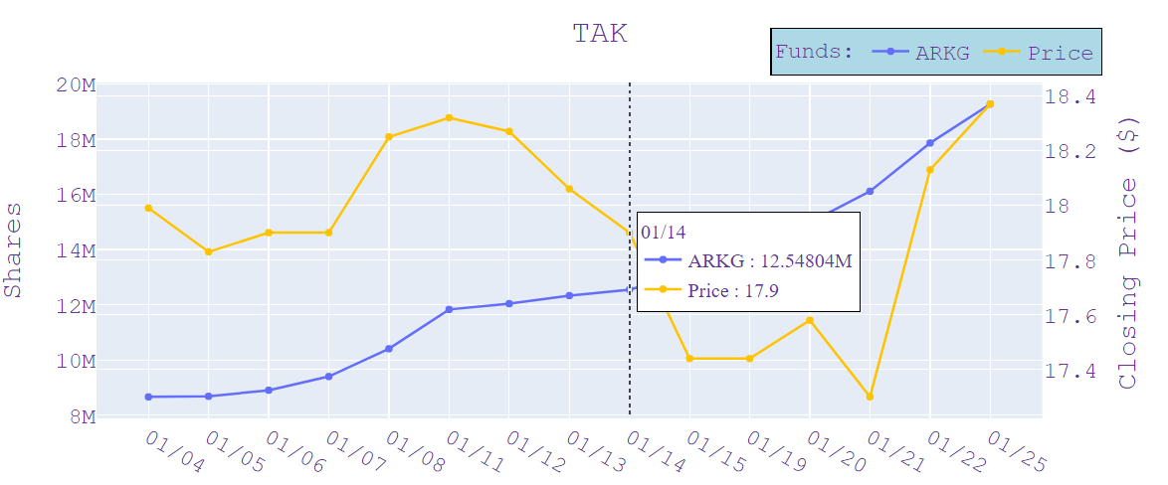
Change log – 1/25
ticker chart
1) Added price
2) Removed the need to click “Update” because the Dropdown() box requires the entry to exist before it can populate anyway

Slide 40
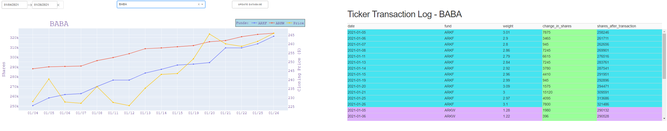
Change log – 1/26
Layout
Managed to format 1st row at top to contain [date_selector, ticker_selector, ‘update_database’ button]
Moved ticker_chart and transaction log to be side-by-side
Note: This picture is taken on 1/27 … color was not present in the 1/26 update

Slide 41
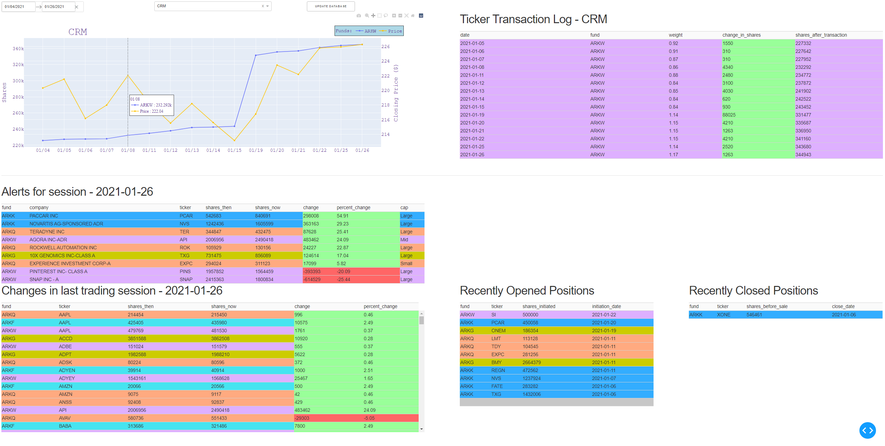
Change log – 1/27
Colorized all tables based on fund value as well as whether the transaction is a BUY (green) or SELL (red)
Formatted ticker_chart a bit (Title now at top left, chart is taller, and added transition animation effects)

Slide 42
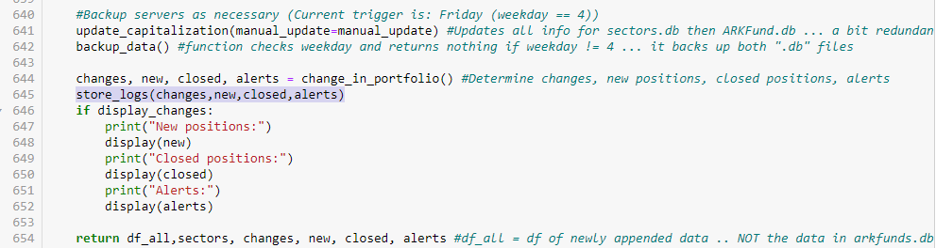
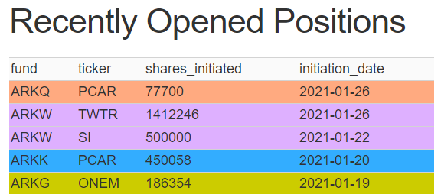
Change log – 1/27
Changed “set_dir()” to have no specific path
Reason:
So the applet can be pushed as a github repo download & fully functional by just running the app.py file
Realized I accidentally `update_arkfund()` did not call `store_logs()` even though I made a note that such a change was done
Code is now there and updates appropriately for the new positions of ‘PCAR’ and ‘TWTR’ on 1/26

Slide 43
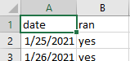
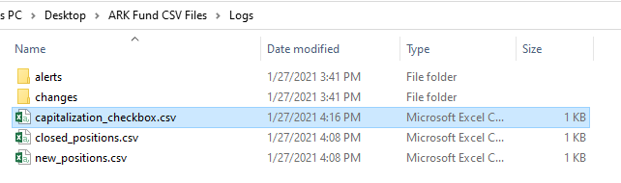
Change log – 1/27
Created ‘capitalization_checkbox.csv’
Contains only 2 columns and the update_capitalization() column will check if the date exists already – if not then it’ll go ahead with the execution (if Friday OR manually requested)
“manual_update” parameter and Fridays for “update_capitalization()”
Issue
The function will run EVERY execution on Friday
Need to log a way to execute it only 1 time on Friday (and also only 1 time if manually requested for the day)

Slide 44
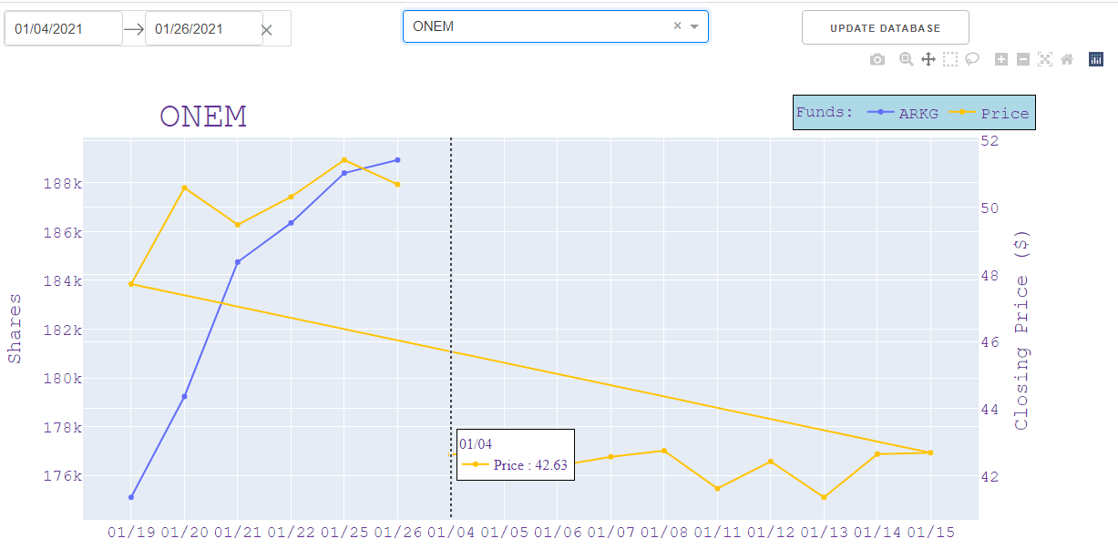
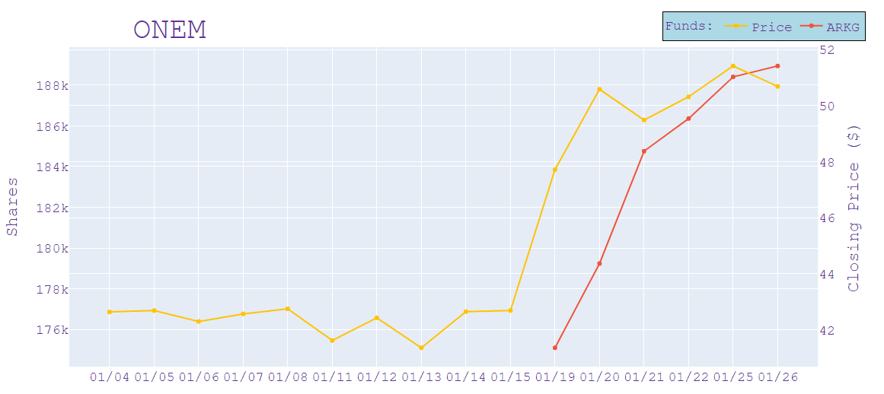
Issues – 1/27
If a position opens and you ask for data prior to the position opening … the price plots (because it exists) for all requested dates but position sizing can only plot for what exists
This leads to this ugly connection & plotting of the price line
Solution:
Plot price before plotting position --- resolves it easily!

Slide 45
Conclusion of project (for now)
Following ARK fund has been a fun journey in both coding and finance (and slightly profitable when following those “recently opened positions” alerts!)
The app functions great for daily analysis of ARK holding’s
However as of current (1/27) I have less than 1 month’s worth of data … not much to run statistics on → Wait till more data comes in! (Plus, I still need to think how to program all that logically before programming it)
Still to do:
0) `Update database` button is non functional
Temporary soln: Reload the app by re-running “py app.py” in your cmd
1) Statistics on positions
2) Pretty up the app more
Background, images, disclaimer text … etc
3) Maybe in the future push this to an actual server & host on a website?

Slide 46
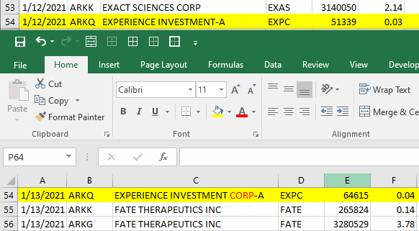
Change log – 2/8
Company name changed for “EXPC” from 1/12 to 1/13
Issue:
Change_in_portfolio() utilizes pd.groupby([‘fund’,’company’,’ticker’,’cap’])
This results in an incorrect detection that “EXPC” was both close & opened from 1/11 to 1/13.
Solution:
None just yet … this is a rare situation and I could simply groupby() without company.
However I would have to then handle the majority case where “company” is still the column name and otherwise try “company_x” as the column name. (Which isnt too hard to do)

Slide 47
Change log – 2/8
New function
Comprehensive_update_new_closed()
New and closed positions are only computed based on the criteria
{What was in the database} vs {what is being fed in today}
Being fed means that it could be a batch of days instead of a singular day
Function purpose
1) Archive & remove the old .csv log
2) Compute new/close positions by iterating through each possible pair of sequential dates
3) Generate new_positions.csv and closed_positions.csv accordingly

Slide 48
Change log – 2/8
Minor changes
Store_logs() was updated to have a new argument that comprehensive_update_new_closed() will call as to limit the number of repetitive/unnecessary calls to functions

